Slide 1
Intro to Terraform
Darren Young darren.young@imanage.com
youngd24@gmail.com

Slide 2
Overview
Take a 1000’ dive into Terraform, what infrastructure as code is, how you can use it today and walk away with working code you can implement.

Slide 3
Contents
About
What is Terraform?
Installation
Configuration & Structure
Workflow
Versus mode
Lab
Revision control integration
Configuration management automation (Ansible, Chef, Puppet, SaltStack)
Other examples
AWS
Azure

Slide 4
About me
Global Cloud Security Operations Manager, iManage
28 years in tech
13 in InfoSec
10 as UNIX admin & system/security architect
5 in various others (dev & network)

Slide 5
What is Terraform?

Slide 6
Infrastructure as Code (IaC)
Wikipedia:
Infrastructure as code (IaC) is the process of managing and provisioning computer data centers through machine-readable definition files, rather than physical hardware configuration or interactive configuration tools.

Slide 7


What’s in it for me? - The good
Automated deployments
Highly repeatable actions
Standardization of configurations
Ability to revision control systems
Single definition, multiple back-ends

Slide 8

What’s in it for me? - The bad
Increased up-front work
Yet another “thing” to learn
Fundamental shift in thinking

Slide 9

What’s in it for me? - The ugly
Generally designed to be highly ephemeral (short-lived)
Assume generally no persistence
Destruction is EASY
Example: changing an IP will redeploy the resource

Slide 10
Installation

Slide 11
Installation
Download binary from https://www.terraform.io/downloads.html
Copy the file somewhere into $PATH (e.g. /usr/local/bin)
OS/X: brew install hashicorp/tap/terraform
Installation Instructions https://learn.hashicorp.com/tutorials/terraform/install-cli

Slide 12
Configuration & Structure

Slide 13
What makes up Terraform?
The Terraform command
Configuration file(s)
Provider(s)
State file(s)

Slide 14
Configuration files
Text files named with a .tf extension
UTF-8 encoded
Normally use UNIX line endings (LF) (but can use Windows CRLF)
Modules - a collection of .tf files in the same directory
Root module is built from the files in the current directory
May reference child modules in other directories
A single .tf file is usually the starting point
https://www.terraform.io/docs/configuration/index.html

Slide 15
Resources
Resources are the most important element in the Terraform language. Each resource block describes one or more infrastructure objects, such as:
virtual networks
compute instances
higher-level components such as DNS records
Each Resource is associated with a Resource Type
Defines the kind of infrastructure object it manages
Implemented by a Provider
https://www.terraform.io/docs/configuration/resources.html

Slide 16
Resource Examples

Slide 17
Providers
Are essentially “plugins” for various infrastructure types
Each provider plugin offers a set of resource types and defines for each resource type which arguments it accepts, which attributes it exports, and how changes to resources of that type are actually applied to remote APIs.
The Terraform Registry is the main directory of publicly available Terraform providers, and hosts providers for most major infrastructure platforms.
You can also write and distribute your own Terraform providers, for public or private use.
https://www.terraform.io/docs/configuration/provider-requirements.html

Slide 18
Using Providers
Terraform finds and installs providers when initializing a working directory
It can automatically download providers from a Terraform registry or load them from a local mirror or cache
When a new provider is added to a configuration, Terraform must install the provider before it can be used
If you are using a persistent working directory, you can run terraform init again to install new providers
Providers downloaded by terraform init are only installed for the current working directory
Other working directories can have their own installed provider plugins, which might be different versions

Slide 19
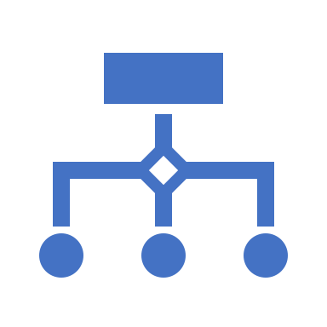
Input Variables
Input Variables
Provide parameters to/for a Terraform module
Allows aspects of the module to be customized without altering the module's own source code
Allows modules to be shared between different configurations.
https://www.terraform.io/docs/configuration/variables.html

Slide 20
Declaring Input Variables

Slide 21
Using Input Variables

Slide 22
State
Terraform stores state about your managed infrastructure
The primary purpose of Terraform state is to store bindings between objects in a remote system and resource instances declared in your configuration.
It maps real world resources to your configuration, keeps track of metadata, and improves performance for large infrastructures.
When Terraform creates a remote object in response to a change of configuration it will:
Record the identity of that remote object against a particular resource instance
Potentially update or delete that object in response to future configuration changes
This state is stored by default in a local file named "terraform.tfstate”
Can also be stored remotely, which works better in a team environment.
https://www.terraform.io/docs/state/index.html

Slide 23
Digging in

Slide 24
Workflow
Init
Plan
Apply
Destroy

Slide 25
init
Used to initialize a working directory containing Terraform configuration files
This is the first command that should be run after writing a new Terraform configuration or cloning an existing one from version control
It is safe to run this command multiple times
https://www.terraform.io/docs/commands/init.html

Slide 26
plan
Used to create an execution plan to deploy resources from
Terraform performs a refresh, unless explicitly disabled, and then determines what actions are necessary to achieve the desired state specified in the configuration files
Convenient way to check whether the execution plan for a set of changes matches your expectations without making any changes to real resources or to the state
If Terraform detects no changes to resource or to root module output values, it will indicate that no changes are required
https://www.terraform.io/docs/commands/plan.html

Slide 27
apply
Used to apply the changes required to reach the desired state of the configuration, or the pre-determined set of actions generated by a terraform plan execution plan
https://www.terraform.io/docs/commands/apply.html

Slide 28
destroy
Used to destroy the Terraform-managed infrastructure.
https://www.terraform.io/docs/commands/destroy.html

Slide 29
Other CLI commands
https://www.terraform.io/docs/commands/index.html

Slide 30
Excample Terraform Config

Slide 31
Example Project Structure
-rw-r--r-- 1 automation automation 1515 Aug 17 03:29 dc6csok8stst01.tf
-rw-r--r-- 1 automation automation 1515 Aug 17 03:29 dc6csok8stst02.tf
-rw-r--r-- 1 automation automation 1515 Aug 17 03:29 dc6csok8stst03.tf
-rw-r--r-- 1 automation automation 1515 Aug 17 03:29 .terraform
-rw-r--r-- 1 automation automation 979 Sep 21 05:57 k8stest.tf
-rw-r--r-- 1 automation automation 7494 Sep 1 22:51 terraform.plan
-rw-r--r-- 1 automation automation 20858 Sep 1 22:52 terraform.tfstate
-rw-r--r-- 1 automation automation 20983 Sep 1 22:52 terraform.tfstate.backup
-rw-r--r-- 1 automation automation 96 Sep 21 05:51 terraform.tfvars
-rw-r--r-- 1 automation automation 435 Sep 21 05:56 variables.tf

Slide 32
Demo Time

Slide 33
Versus…

Slide 34
Vagrant
Vagrant is a tool focused for managing development environments
Terraform is a tool for building infrastructure
Terraform can describe complex sets of infrastructure that exist locally or remotely
Vagrant provides several higher-level features, to ease development usage, that Terraform doesn’t:
synced folders
automatic networking
HTTP tunneling
Vagrant is for development environments. Terraform is for more general infrastructure management

Slide 35
Ansible/Chef/Puppet
Terraform is not a configuration management tool, and it allows existing tooling to focus on their strengths: bootstrapping and initializing resources
Using provisioners, Terraform enables any configuration management tool to be used to setup a resource once it has been created
Terraform focuses on the higher-level abstraction of the datacenter and associated services, without sacrificing the ability to use configuration management tools to do what they do best

Slide 36
My use cases
All Security Operations infrastructure
Splunk Attack Range
Automated security control regression testing

Slide 37
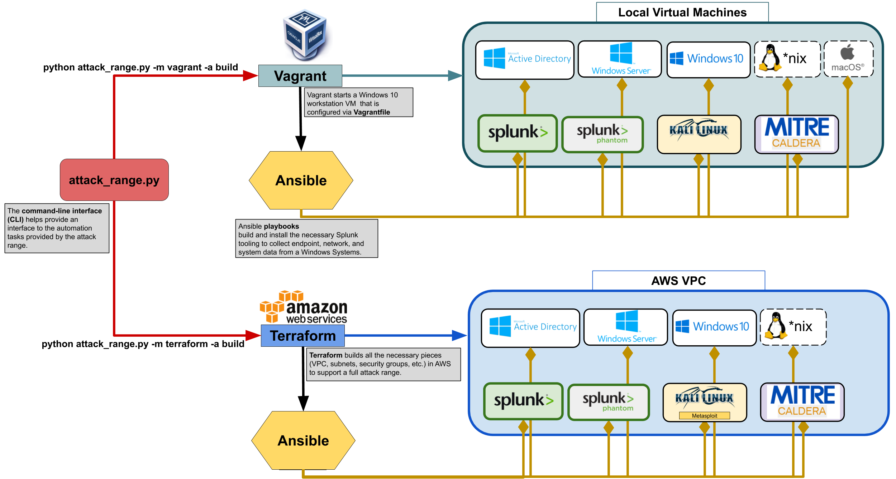
Splunk Attack Range

Slide 38
Examples
AWS
https://github.com/terraform-providers/terraform-provider-aws/tree/master/examples/two-tier
https://registry.terraform.io/providers/hashicorp/aws/latest/docs
Azure
https://www.terraform.io/docs/providers/azurerm/index.html
https://github.com/terraform-providers/terraform-provider-azurerm/tree/master/examples/virtual-machines/virtual_machine/bastion-box

Slide 39
Other Resources
https://github.com/hashicorp/terraform/tree/master/examples
https://github.com/terraform-providers
https://github.com/josenk/terraform-provider-esxi

Slide 40

This info…
https://github.com/youngd24/TerraformDemo

Slide 41

Q&A

